Slide 1
The Paperazzi
Toshinao Iwaki
Tim Hao Li
Martin Pettersson
Patrick Tsao

Slide 2
The Cruel Reality
Aspiration
Reality
Zoom-able graph interface
Paper nodes / edges
Author nodes / edges
Information
Details per paper
Link to PDF
Facets
# inbound citations
Year range
Zoom-able graph interface
Paper nodes / edges
Information
Details per paper
Link to PDF

Slide 3
Demo
http://rosina.cs.washington.edu:8080

Slide 4
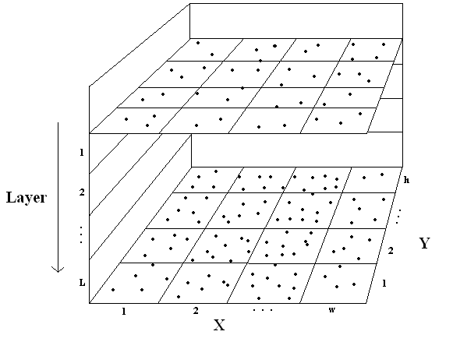
Node Positioning
Spatial
Partitioning
Citations:
To graph:
10.1.1.35.5874 → 10.1.1.10.3314
10.1.1.87.6761 → 10.1.1.10.3314
10.1.1.110.8953 → 10.1.1.1.7533
10.1.1.42.1417 → 10.1.1.1.7533

Slide 5
Usability (or lack thereof)
Spatial relationship is ambiguous
The graph cannot stand on its own
Still needs the list of results with words
Users can get lost in all the different nodes
Which ones do I care about?
Discovering is useful
But don’t show everything

Slide 6
The Need for Speed

Slide 7
The Need for Speed

Slide 8
Lessons Learned
Many useful open source projects out there
Some are well-documented
Take advantage of sample code
Don’t always trust open source code
Don’t be afraid to fix bugs either
Java plug-ins for browsers are hard to work with
Flakey at times

Slide 9
Surprise!!
CiteSeerX is very flakey
Lucene is pretty fast!
Lucene release cycle is ~2 weeks
Attu was a pain to work with
Permission errors
Connection refuse
Tomcat was hard to debug with
Error messages were not informative

Slide 10
Where Credit is Due
Toshi
Cora data parsing
Relevance algorithm
Servlet API expansion
Tim
Data harvesting
Building index
Performance testing
Martin
UI development
Applet
Architecture design
Patrick
UI design
Usability testing
Architecture design

