Slide 1
RouteBook
A consolidated source of hike information from across the web

Slide 2
The Webcrawler
SummitPost.org
wget
Classifier
Hike pages
wget
Localhikes.com
wget
TheBackpacker.com

Slide 3
Classifier
HTML Extractor
Don’t need HTML tags, JS, or CSS
Keyword Extractor
Keyword Classifier

Slide 4
Keyword Extractor
Given a sentence
Chop up the words
Remove sentence punctuation
Stem word.
Remove –er suffix
He says, “RouteBook is Awesome.”
awesom

Slide 5
Keyword Classifier
Classifier Problem
Traditional binomial classifier
Positive Set: Trails and hiking (easy!)
Negative Set: Everything else!
Assigns weights based on keyword frequency
Generates score as ∑(keyword weight x keyword occurrence)
Remove stopwords and common words
Sensitive to word frequency

Slide 6
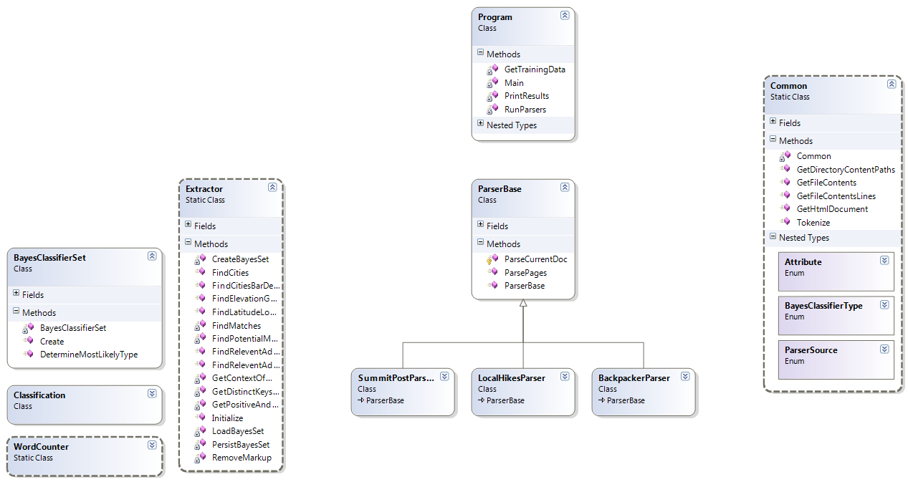
Information Extractor
CSV Output
Files
Word Lists
Training Data
Common Extraction
Specialized Extractors

Slide 7
Information Extractor Test Results
 | TP | TN | FP | FN
Untrained Adj | 372 | 0 | 428 | 0
Trained Adj | 298 | 429 | 1 | 72
 | TP | TN | FP | FN
Untrained City | 174 | 0 | 426 | 0
Trained City | 133 | 429 | 0 | 38

Slide 8
The Database
Remove duplicates, merge new information
Name
Latitude
Longitude
Description
……
IE CSV Entries
Filter and Merge
Hikes DB

Slide 9
The Front End
New Hike from User
Result Hikes
Hikes DB
User Query
Location DB
Hike Update from User

Slide 10
Credits!
Chad Mackley – Crawler
James Hu – Classifier
Michael Luoma – Information Extractor
Josh Goodwin – Database and Front End
Questions?

