Slide 1
craigslist++
sean anastasi
joseph chen
tatiana gershanovich
andreas sekine

Slide 2
our goal
to enhance craigslist’s interface
show related items also being sold at craigslist
show related items from other third-party sites

Slide 3
how we do it
main components
crawler (heretrix)
clusterer (carrot2)
relevance sorting
user interface (greasemonkey)
other stuff

Slide 4
crawler
specific crawling needs
volatile data
questionable legalities
heritrix
only crawling one domain
problematic setup
our setup
2 crawlers for new posts, 1 cleaner

Slide 5
clusterer
Carrot2
what to cluster (title, body or title + body)?
need of reclustering and combination
WordNet
combination of synonym clusters

Slide 6
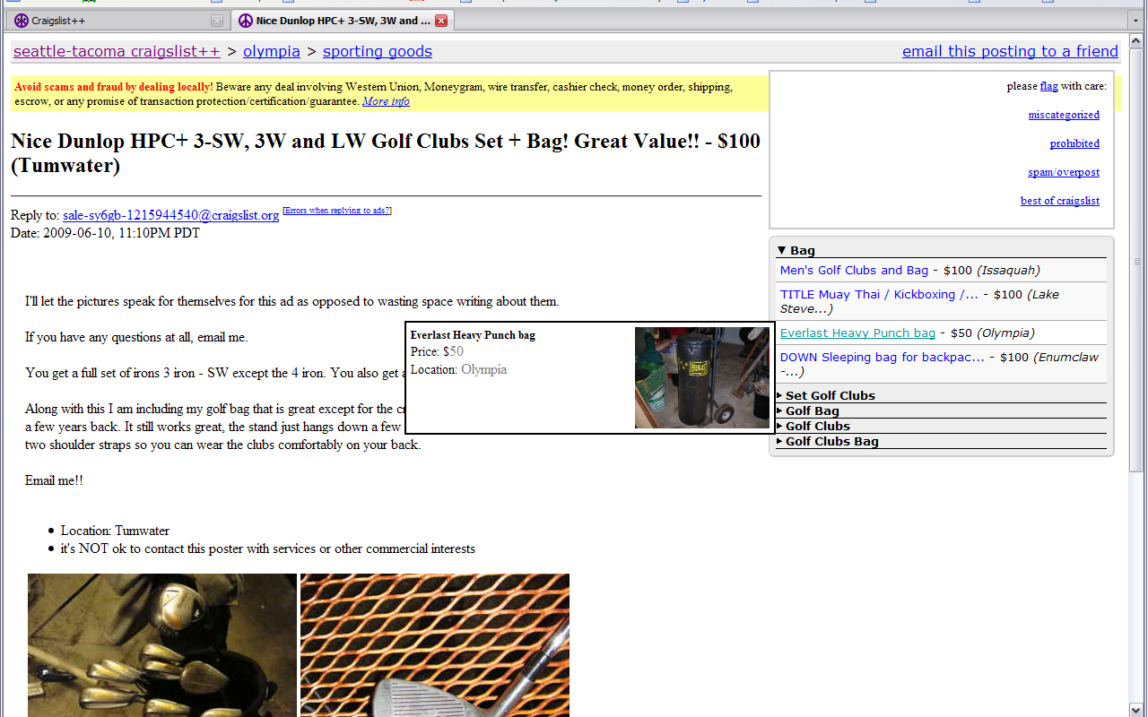
relevance sorting

Slide 7
relevance sorting (cont.)
cse454 craigslist++

Slide 8
user interface
greasemonkey
show related posts (grouped by clusters)
show which items have data
jquery
folding item lists
mouseover details/images

Slide 9
other
amazon product advertising api
yahoo term extraction
botnet

Slide 10
demo
greasemonkey plugin
https://addons.mozilla.org/en-US/firefox/addon/748
craigslist++ script
http://cubist.cs.washington.edu/~lidor7/craigslistpp.user.js
craigslist
http://seattle.craigslist.org/

